Slide 1
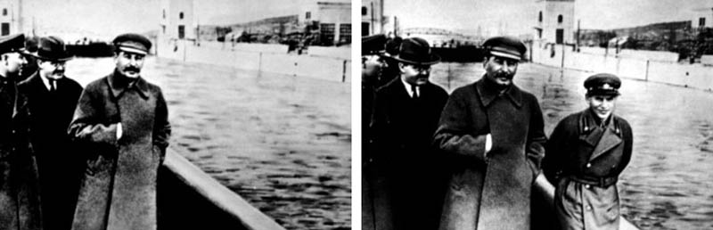
Module 2.e: Image tampering and detection approaches
By Author
Date

Slide 2
Outline
Image tampering
Background
The importance of image tampering detection nowadays
Common image operations
Issues to address
Our experiment

Slide 3


Image tampering
The editing of multimedia content with malicious intent (e.g., to change a piece of information).
Example: pretend that pink was not at the party.
Crop & Resize
“Pink was not at the party”
Actual photo at the party
Notes:
Resize the image to its original size to make it appear similar to all other photos. As an example, seam-carving is a very recent operation that can do this work very well.

Slide 4
Image tampering
The editing of multimedia content with malicious intent (e.g., to change a piece of information).
This involves:
Object removal (often replaced via inpainting)
Object insertion (a.k.a. splicing)
Object duplication (a.k.a. copy-move)
Common operations, like enhancement or compression, are not malicious but they can be used to wipe out tampering traces.

Slide 5
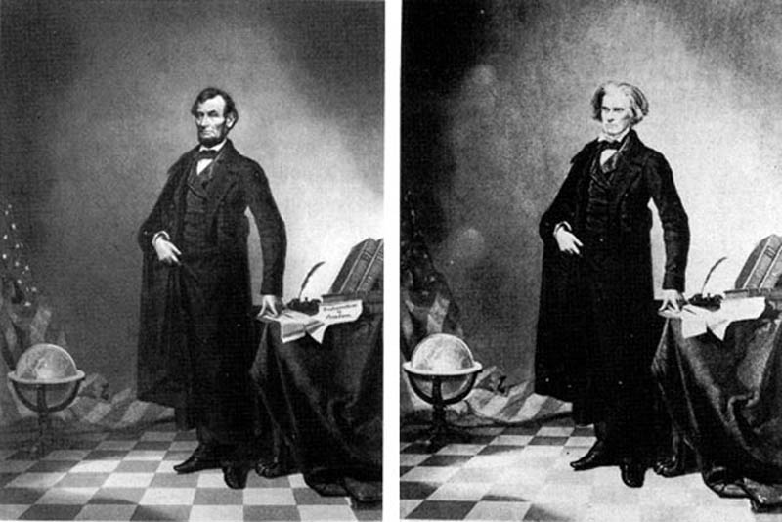
Background
Image tampering was born together with photography. It has been often employed for politic reasons.
Example of splicing operation: the head of A. Lincoln is pasted
in a photo of J. Calhoun, circa 1860.
This is one of the earliest known tampered images.
Tampered
Pristine
Notes:
After splicing a region in a new image, the user has to smear object edges, correct brightness, and so on. Each operation leaves some traces, even if subtle. These traces are exploited to detect image tampering.

Slide 6
Background
Image tampering born together with photograph. It has been often employed for politic reasons.
Example of inpainting operation: in a photo depicting J. Stalin, a person has been removed for propaganda purpose, circa 1930.
Tampered
Pristine
Notes:
In this case, the background (that is the water) is generated from surrounded pixels to cover the person. This makes the generated pixels more correlated each other. This kind of correlation is one of the traces exploited by tampering detectors.

Slide 7
The importance of image tampering detection nowadays
Tampering an analog photo requires high-level photographic skills.
In the last decades, the advent of digital imaging and advanced softwares has made image tampering easier, cheaper, and much more effective.
Very recently, artificial intelligence tools allow an unexperienced user to edit images or video or generate new ones from scratch.
The threat of fake news exploiting tampered multimedia make it necessary to design automatic tampering detection tools.

Slide 8
Common image operations
Local operation (e.g., splicing, or inpainting)
It is always intentional;
Involves local enhancements and adjustments
Leaves subtle traces that can be localized.
Global operations (e.g., resizing):
Can be intentional or unintentional (i.e., social posting);
Can be used to wipe-out local manipulation traces;
Leave new traces (like pixel correlation) all over the image.
Notes:
local enhancements and adjustments are used to make the manipulated region appear as natural as possible

Slide 9
Issues to address
Traces left by manipulations are:
Different: each operation leaves its own traces, thus needs its own detector.
Tiny: they can be confused with noise.
Targeted by anti-forensics techniques that wash-out them by using legit operations like social posting or ad hoc attacks.
Notes:
local enhancements and adjustments are used to make the manipulated region appear as natural as possible

Slide 10
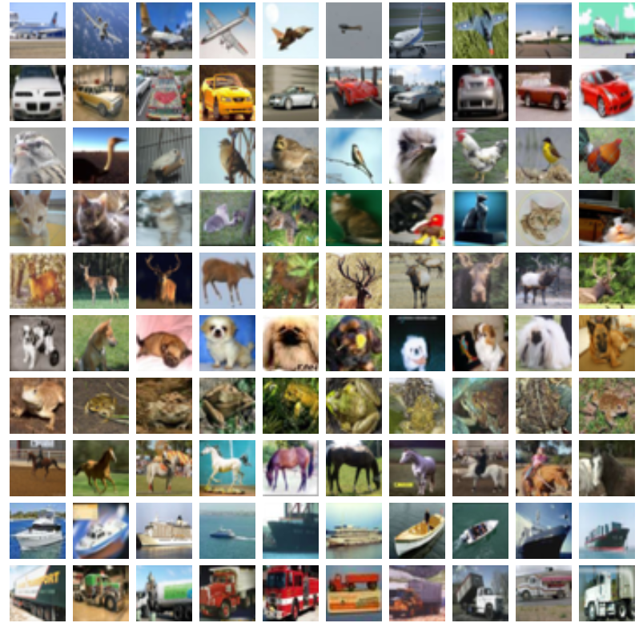


Our experiment
Take the CIFAR-10 dataset
Generate “tampered” images via resize & crop
32 px.
32 px.
32 px.
32 px.
Pristine
Tampered
Notes:
The CIFAR-10 dataset is used here because it is small and easy to manage.
Resize and crop is a simple way to make the image appear different, like a chicken of a different species or pretending that the boat was stopped.
This is obtained without introducing visual artifacts but subtle traces in the relationships between adjacent pixels.

Slide 11
Our experiment
Train a classifier to tell apart tampered images from pristine ones
Extract local image descriptors and use them to train a Support Vector Machine
Train a Convolutional Neural Network
Pristine
Tampered

